Slide 1
CULTURAL ANALYSIS

Slide 2
Most of our (the students’) sounds are related to our personal life, as everybody might expect (maybe). In fact, we can hear sounds connected with daily activities: school, sport, leisure time and so on. Moreover, some students who own pets recorded sounds which show their special relationship with their “little” friends.

Slide 3
Some sounds may be defined “intercultural” (i.e. bells, making/pouring coffee), as they cannot be considered just typical of a certain culture.

Slide 4
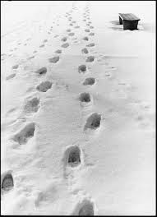
On the other hand, a few sounds (for example, footsteps in the snow) may be considered as “deriving” from the environment a person lives in and, consequently, they are an important part of the cultural background of a specific country, which is also expressed through customs and traditions, i.e. some of the fundamental elements of the culture of that nation.

Slide 5
Working on our project, we had to think about the sounds which “describe” our personality. This activity has made us all aware of the fact that we do not often pay attention to our typical soundscape, i.e. the “sounds” characterising our environment. Of course, we listen to music, we sing, we hear noises and, sometimes, we complain about them, but we often disregard the “simple”, everyday sounds that make our life unique and, in some cases, recognizable as the life of a person living and working in a specific geographical and cultural environment. Our personal “soundscape”…

Slide 6
By the way, do you know who coined the word “soundscape”?

Slide 7
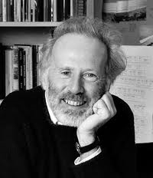
Here’s the answer: the Canadian environmentalist, writer, composer and music educator Raymond Murray Schafer.

Slide 8
In his introduction to his book “The Soundscape: our sonic environment and the tuning of the world”, Schafer writes: “The soundscape of the world is changing. Modern man is beginning to inhabit a world with an acoustic environment radically different from any he has hitherto known. […] Noise pollution is now a world problem […] and many experts have predicted universal deafness as the ultimate consequence unless the problem can be brought quickly under control.”

Slide 9
Schafer’s work contributed to the development of acoustic ecology, an interesting field of study.

Slide 10
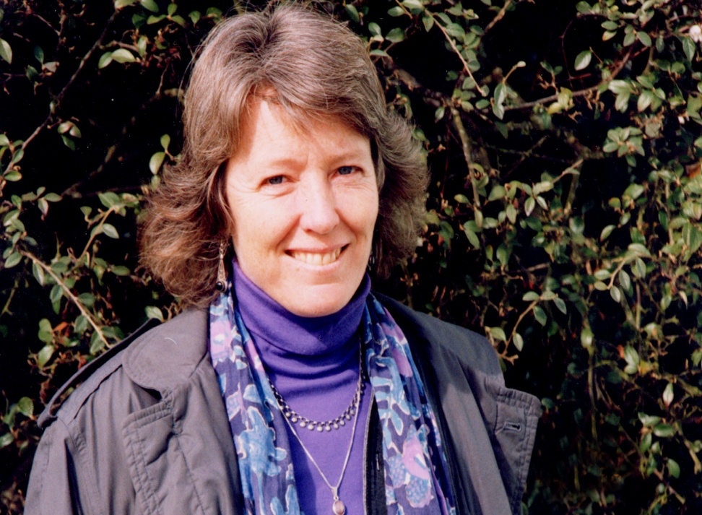
As Hildegard Westerkamp writes in her editorial (Soundscape – The Journal of Acoustic Ecology – vol. 1, n° 1, spring 2000): “Daily practice of listening develops in each one of us a conscious physical, emotional, and mental relationship to the environment. And to understand this relationship is, in itself, an essential tool for the study of the soundscape and provides important motivation for engaging with today’s acoustic ecology issues […] Acoustic Ecology is a relatively new field of study and is in the process of defining itself.”

Slide 11
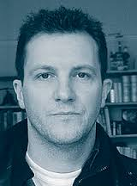
In the same above-mentioned journal, Kendall Wrightson writes:
«Schafer suggests that there are two ways to improve the soundscape. The first is to increase sonological competence through an education programme that attempts to imbue new generations with an appreciation of environmental sound. This he believes, will foster a new approach to design —the second way — that will incorporate an appreciation of sound and thus reduce the wasted energy that noise represents. Schafer’s ideas are laudable and I endorse them. However it is vital that Acoustic Ecologists do not underestimate what Schafer is asking; in order to listen we need to stop or at least slow down— physically and psychologically, becoming a human being instead of a “human doing.” »

Slide 12
In our present society, where so many serious and difficult problems have to be tackled, that’s what we should try to be – always: HUMAN BEINGS not “HUMAN DOINGS”.

Slide 13
WEBSITES:
http://sed.ucsd.edu/files/2014/01/schafer_1.pdf
http://wfae.proscenia.net/journal/scape_1.pdf

Slide 14
Students:
Antonella Cieri Immacolata Magnotta
Teacher :
Anna Rita Margio

